Slide 1

SpotiData Project
Why do we listen to the music we listen to? An analysis of trends on Spotify

Slide 2
Choosing The Data
We have worked with 3 initial datasets:
The most streamed songs
The Top-100 songs of each year of the last 20 years (2000-2021)
The most streamed artists
From chartmasters.org and chart2000.com

Slide 3
Setting Up Our Spotify Developer Account
Log In to Spotify Developer
Create a project
Retrieve Client ID and Client Secret (API Key)

Slide 4
Exploring Spotify Web API Resources
Read the Documentation
Look for the data endpoints we have access to
Go deeper into the Audio Analysis section

Slide 5
The most streamed songs of all time

Slide 6
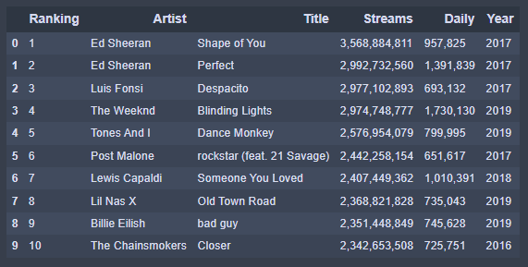
TOP 10

Slide 7
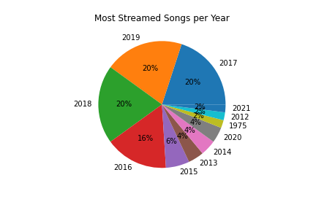
From which year are the most streamed songs
More than half of the most played songs are from 2017, 2018 and 2019.

Slide 8
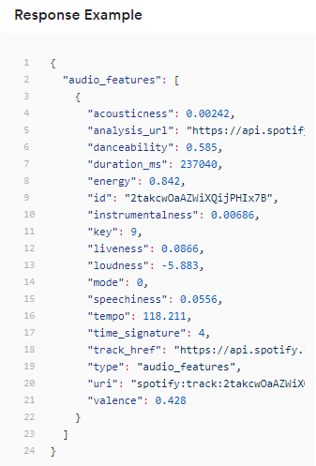
Spotify API Audio Features
Through Spotify audio analysis API
we have requested and analysed audio features such as:
Acousticness Danceability Duration Energy Instrumentalness | Liveness Loudness Speechiness Tempo Valence

Slide 9
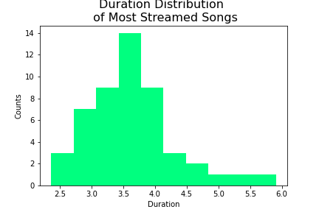
Duration
Median = 3,5
The duration of the track in minutes.
Most songs are between 3 and 4 minutes.

Slide 10
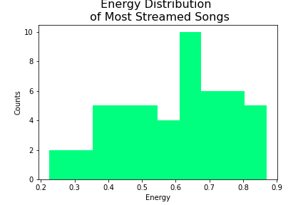
Energy
Median = 0,62
Energy is a measure from 0.0 to 1.0 and represents a perceptual measure of intensity and activity. Typically, energetic tracks feel fast, loud, and noisy. For example, death metal has high energy, while a Bach prelude scores low on the scale.

Slide 11
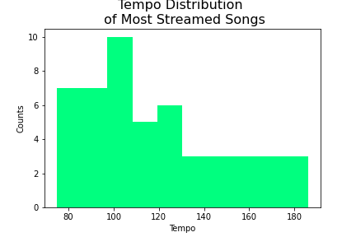
Tempo
Median = 112
The overall estimated tempo of a track in beats per minute (BPM). In musical terminology, tempo is the speed or pace of a given piece and derives directly from the average beat duration. 108–120 BPM is Moderate, 120–168 BPM is Fast, Very fast is 168–200 BPM.

Slide 12
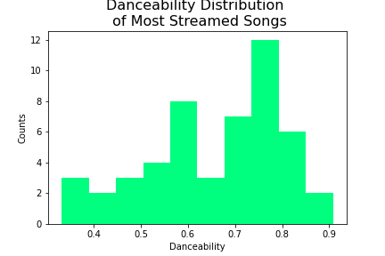
Danceability
Median = 0,69
Danceability describes how suitable a track is for dancing based on a combination of musical elements including tempo, rhythm stability, beat strength, and overall regularity. A value of 0.0 is least danceable and 1.0 is most danceable.

Slide 13
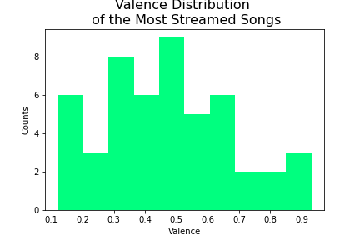
Valence
Median = 0,45
A measure from 0.0 to 1.0 describing the musical positiveness conveyed by a track. Tracks with high valence sound more positive (e.g. happy, cheerful, euphoric), while tracks with low valence sound more negative (e.g. sad, depressed, angry).

Slide 14
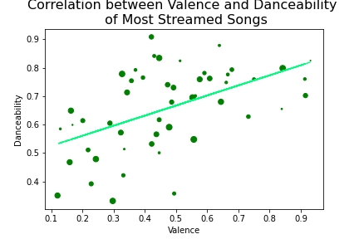
Correlation
between Valence and Danceability
Correlation = 0,52
Moderate positive correlation
Group of low Valence and high Danceability

Slide 15
The Top-100 songs of each year
of the last 20 years (2000-2021)

Slide 16



How has Chart Music Changed over the Past 20 years?
Notes:
Over our lifetimes and in particular from the turn of the millennium, technology has developed in ways we couldn’t have ever fathomed. With developments such as multi terabyte hard drives from floppy disks storing a couple megabytes. The evolution of data transfer in terms of speed and size, with the ability to do this wirelessly. Also the rise of social media and the influence it has had on the younger generation.
All these factors along with many other factors have had major impacts on the music industry with it being easy than ever to stream music. These have also cause changes in the trends of the most popular music. Spotify being the leading platform for streaming music.

Slide 17
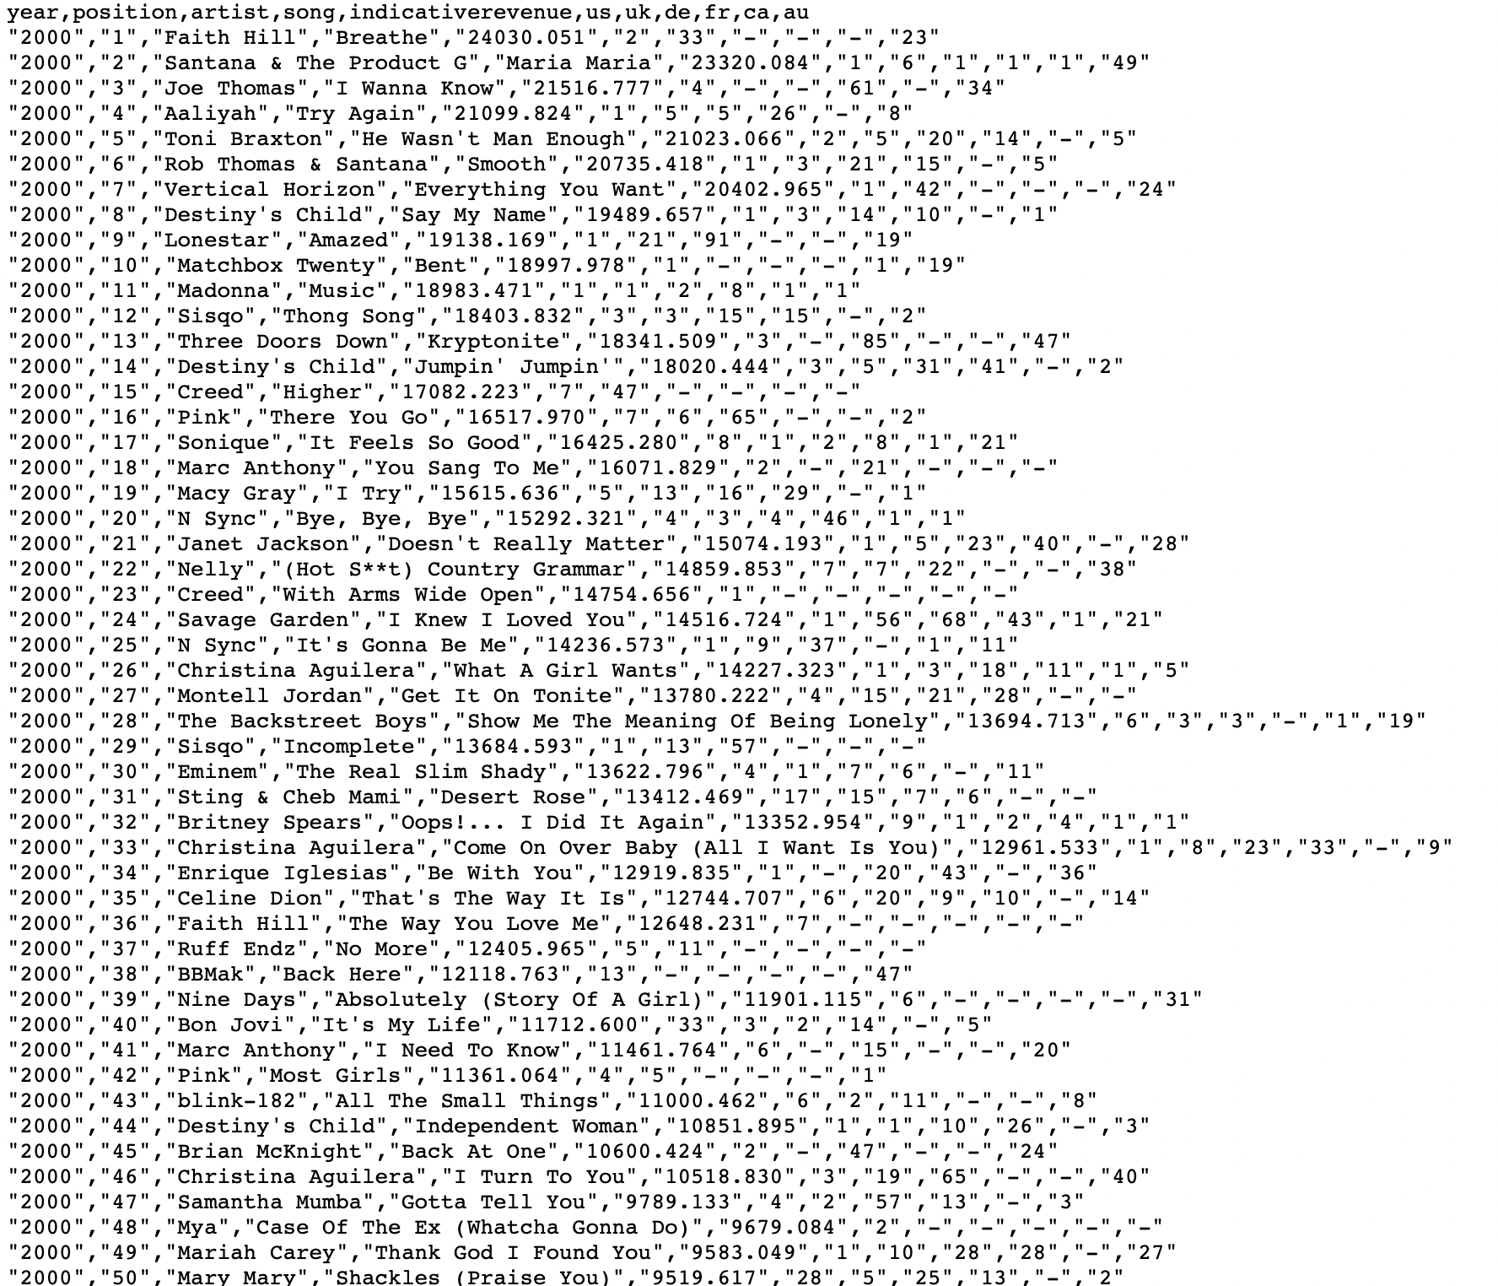
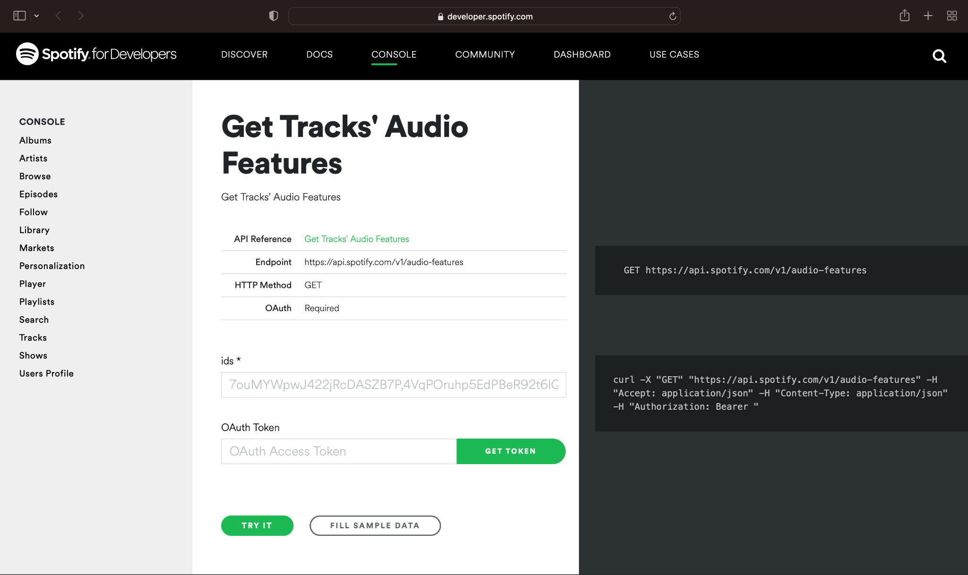
Retrieval of Data
How?
Data Source: https://chart2000.com/about.htm#google_vignette
Notes:
The original data was found from https://chart2000.com/, which held information on the top 100 songs based of revenue from each year starting at 2000 and ending at 2021. Alongside the use of the spotify API, it was made possible to analyse the trends.

Slide 18
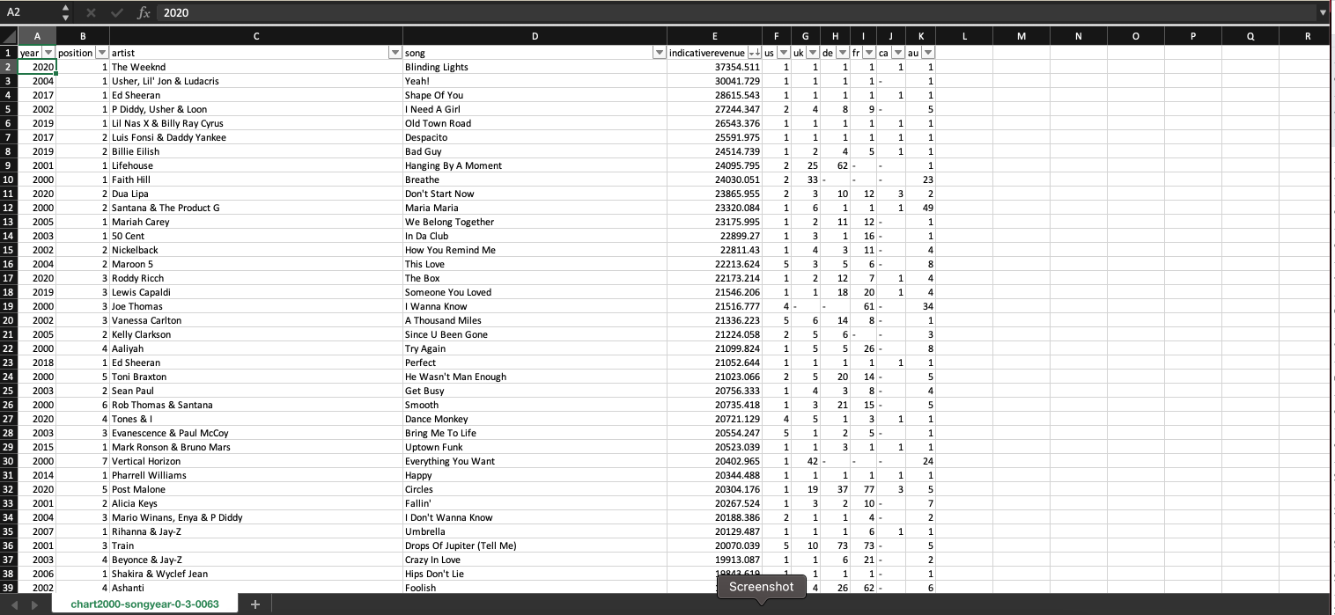
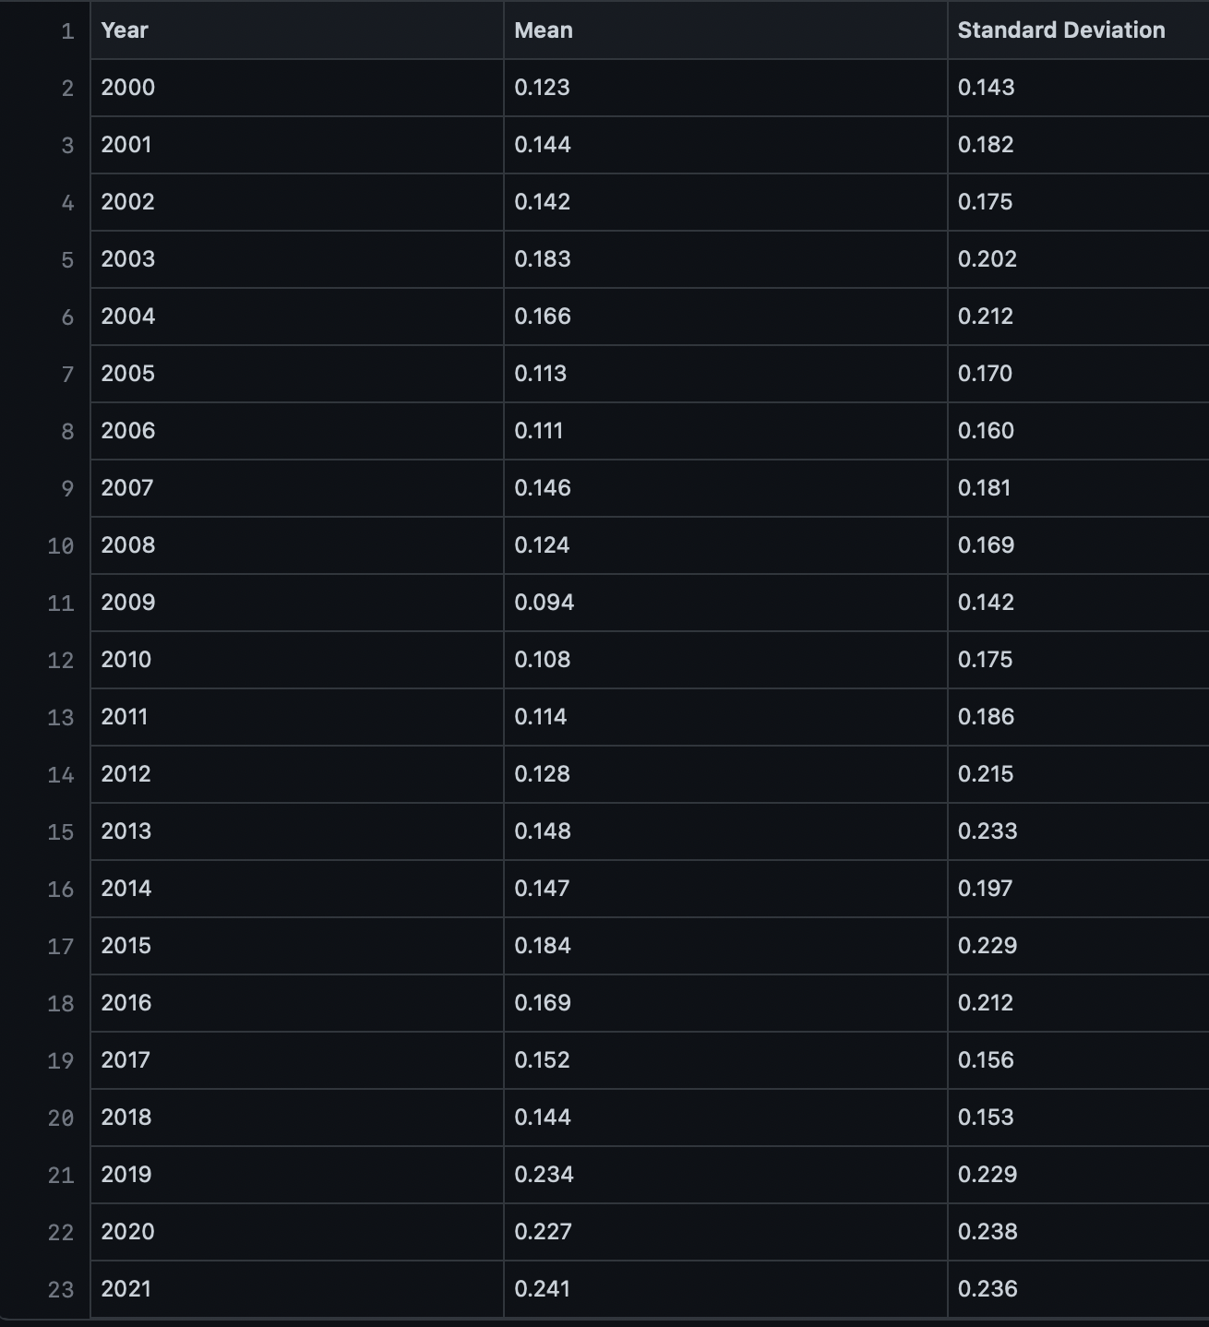
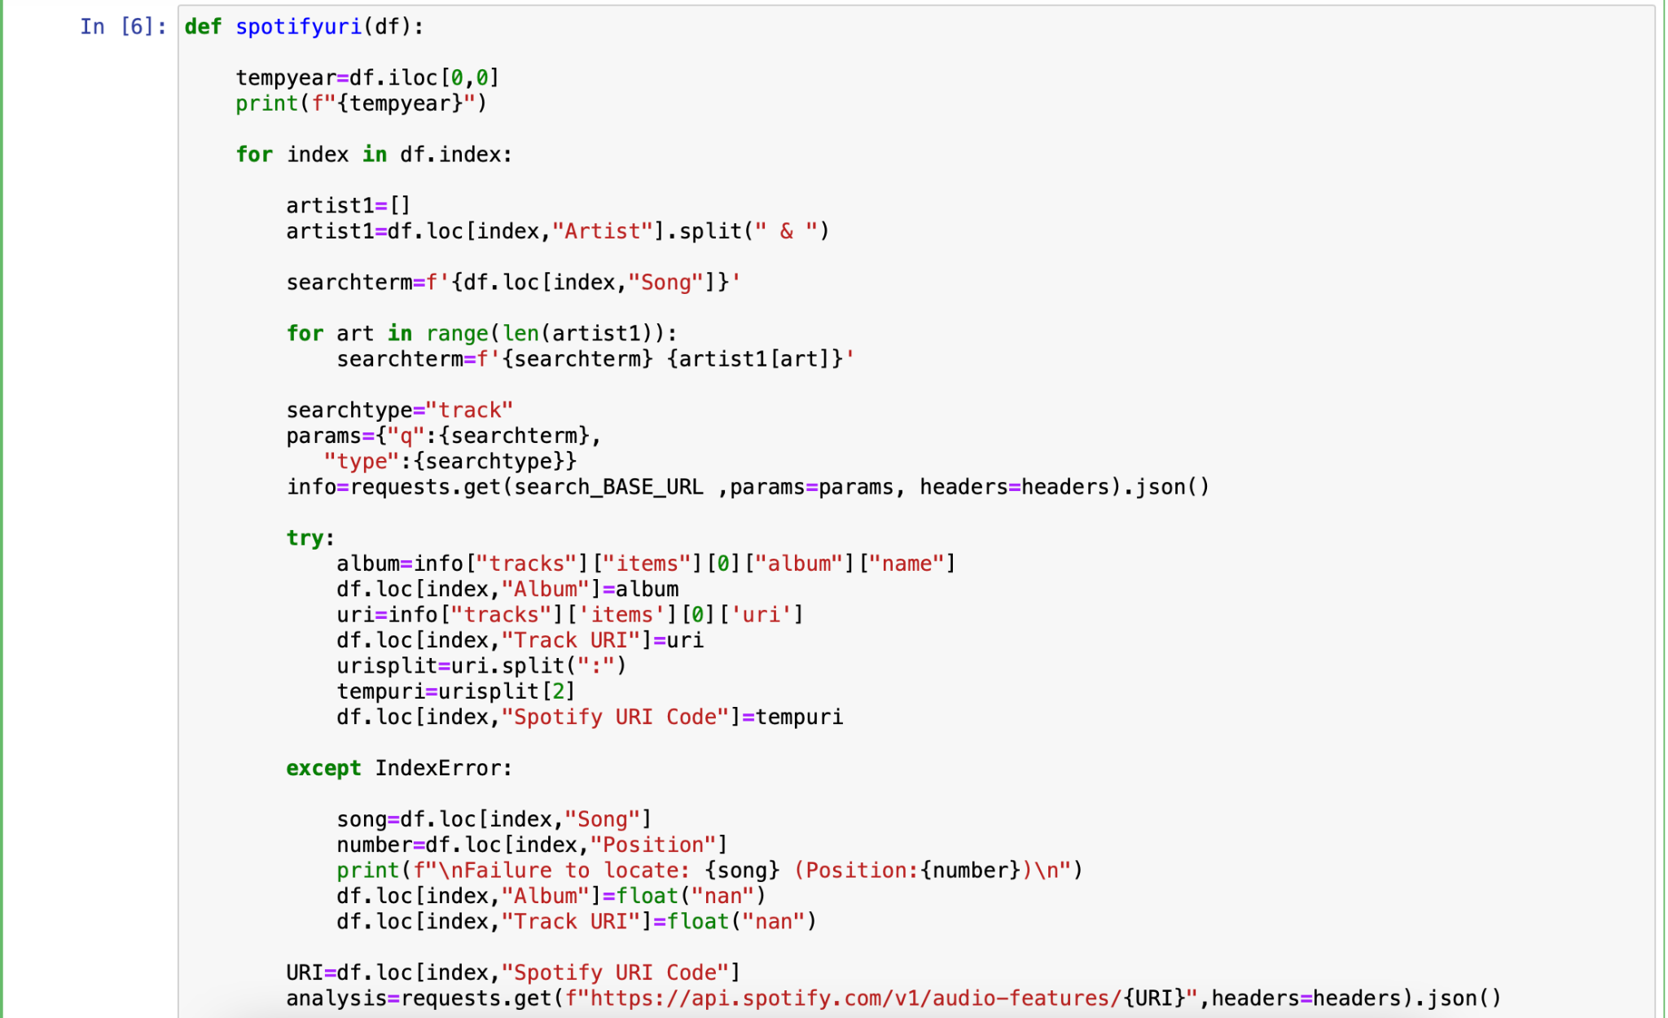
Data Preparation
Notes:
The starting data held 2200 rows with 11 columns, the important data was the first 4 which were year, position, song and artist. So the other columns were removed. The most important process was the understanding and extraction from the Spotify API. So using the song and artist I was able to query using the search api where the search term was a combination of artist name and song name and the type being track, the output that was needed was the spotify uri (the unique id for tracks and artists) . Which gives the opportunity to then extract the vital audio analysis. Unfortunately not all the songs were found due to different issues with the inputs from the table. So the null values were removed. With there being at least 96 remaining out of the 100 for each year.
Then using groupby with aggregate by using mean and standard deviation, i was able to create errorbars/plot to show the evolution. Along with the use of ANOVA test i was able to fail to reject some null hypotheses, and outputting the results in a .txt file.

Slide 19
Definition of some more Audio Features
Acousticness: A confidence measure from 0.0 to 1.0 of whether the track is acoustic. 1.0 represents high confidence the track is acoustic.
Liveness: Detects the presence of an audience in the recording. Higher liveness values represent an increased probability that the track was performed live. A value above 0.8 provides strong likelihood that the track is live.
Loudness: The overall loudness of a track in decibels (dB). Loudness values are averaged across the entire track and are useful for comparing relative loudness of tracks. Loudness is the quality of a sound that is the primary psychological correlate of physical strength (amplitude). Values typically range between -60 and 0 db.
Speechiness: Speechiness detects the presence of spoken words in a track. The more exclusively speech-like the recording (e.g. talk show, audio book, poetry), the closer to 1.0 the attribute value. Values above 0.66 describe tracks that are probably made entirely of spoken words. Values between 0.33 and 0.66 describe tracks that may contain both music and speech, either in sections or layered, including such cases as rap music. Values below 0.33 most likely represent music and other non-speech-like tracks.
Notes:
Acousticness: A confidence measure from 0.0 to 1.0 of whether the track is acoustic. 1.0 represents high confidence the track is acoustic.
Liveness: Detects the presence of an audience in the recording. Higher liveness values represent an increased probability that the track was performed live.
Loudness: The overall loudness of a track in decibels (dB). Loudness values are averaged across the entire track and are useful for comparing relative loudness of tracks. Loudness is the quality of a sound that is the primary psychological correlate of physical strength (amplitude).
Speechiness: Speechiness detects the presence of spoken words in a track. The more exclusively speech-like the recording (e.g. talk show, audio book, poetry), the closer to 1.0 the attribute value.

Slide 20
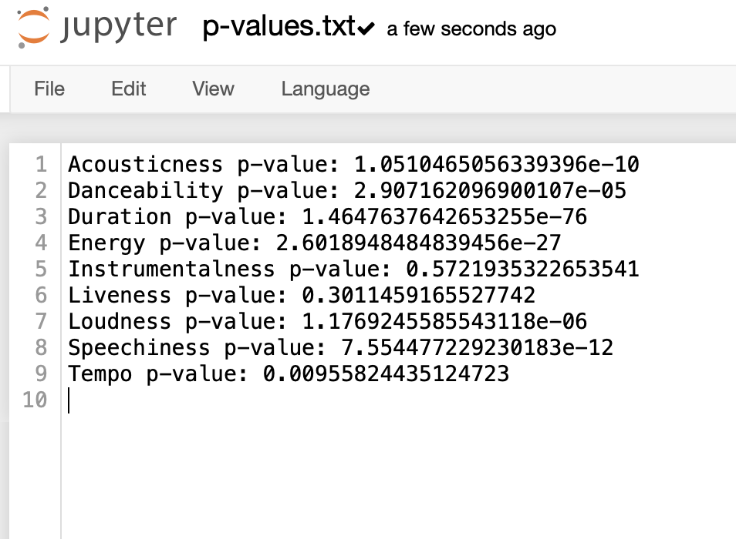
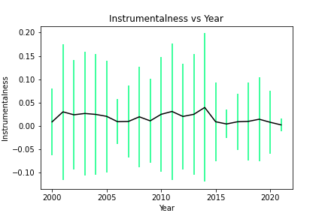
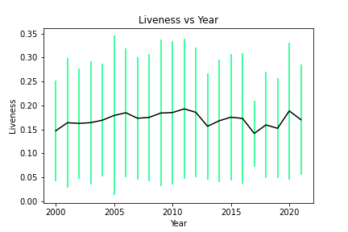
Notes:
After using the ANOVA test, 2 p-values were above the threshold of 0.05 therefore it fails to reject the null hypothesis. Where the null hypothesis’ are the distribution of the audio features haven’t changed over the past 22 years. Showing that instrumentalness and liveness have changed very little, which is also supported by the errorbars, where the means have remained similar and throughout the standard deviations have remained pretty similar and not increased too much.

Slide 21
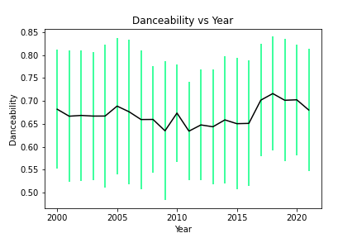
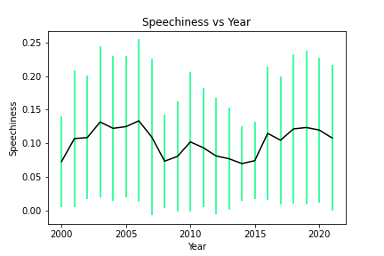
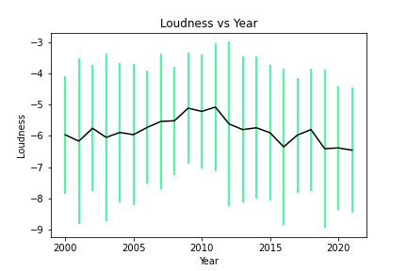
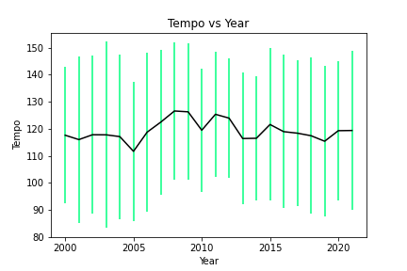
Notes:
Danceabiilty has remained very similar except for a slight increase towards the end moving from the 0.65-0.68 and then moving to 0.7. But the spread has remained very similar with it being about 0.125 to 0.15.
Speechiness has been fluctuating in terms of both spread and mean, showing no clear trend, which in turn shows thats speechiness potentially has less impact on the sales.
Loudness has a slight rise then a steeper incline moving from an average of -6db to about -6.5db. with the spread remaining even.
Tempo has remained similar except for the 2009-2013 where there are many fluctuations, but spread are similar.

Slide 22
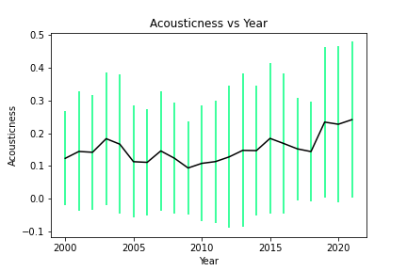
Notes:
Acousticness towards the end of the time period has both an increase in the mean and standard deviation which suggests that the importance of this has decreased on a specific amount of acoustic, as a larger variation of acoustic in a track can succeed. The average is on a upward trajectory towards the end going from 0.15 to 0.23 and the std going from 0.2 to 0.23.

Slide 23
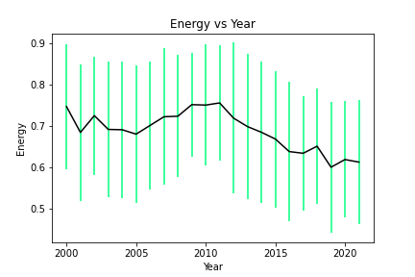
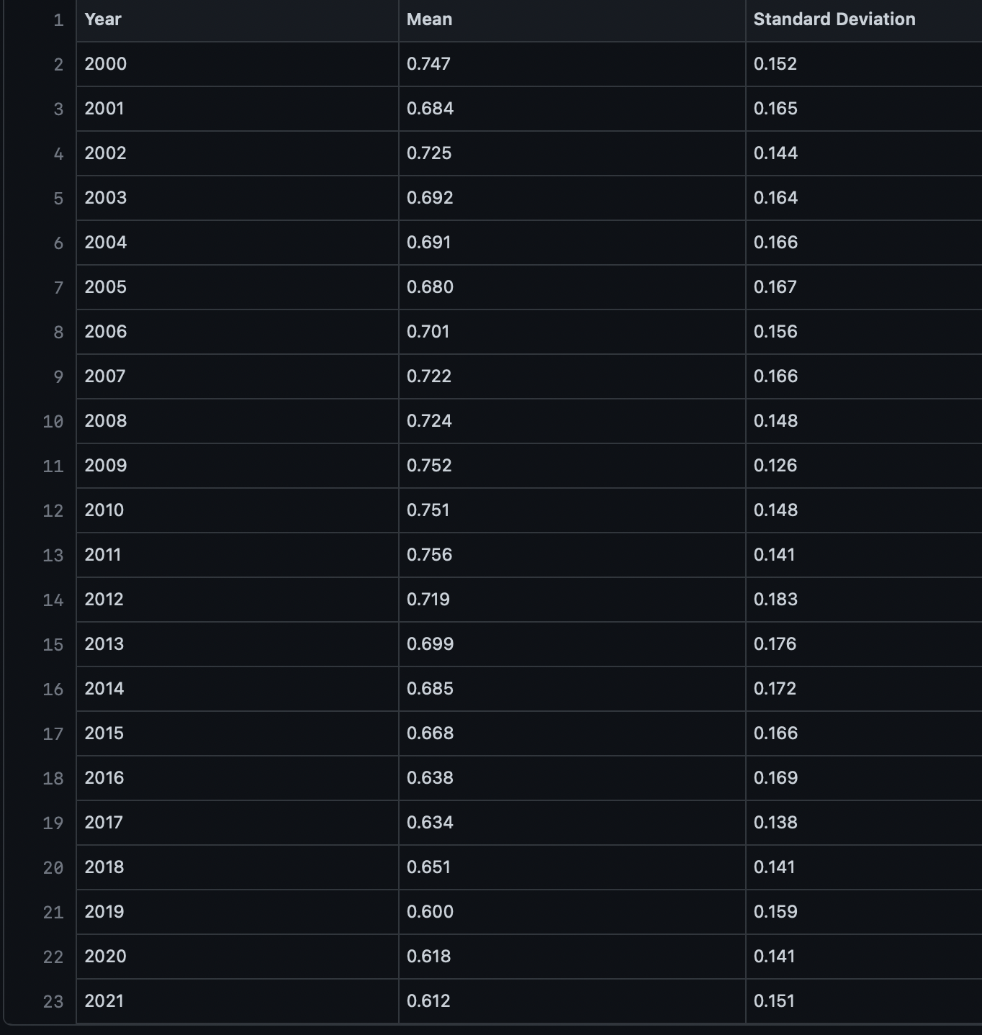
Originally there is a very slight incline up to 2010/11 but then it significantly drops
Mean goes from 0.7 to 0.6
Spread does fall slight after a big rise in 2012
Standard Deviation 0.17 to 0.15
Notes:
Now we come onto the biggest changes over the past 20 years.
As you can see the energy goes on quite a journey, the average goes up then has quite a big fall. The spread remains pretty similar showing that an artist can go for a larger variation of energy and still succeed..
The peak is about 0.75 then falls consistently to 0.6, with the spread reaching similar levels to those in early 2010s with standard deviation being 0.15.

Slide 24
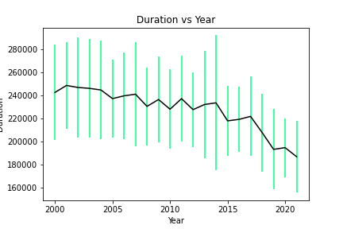
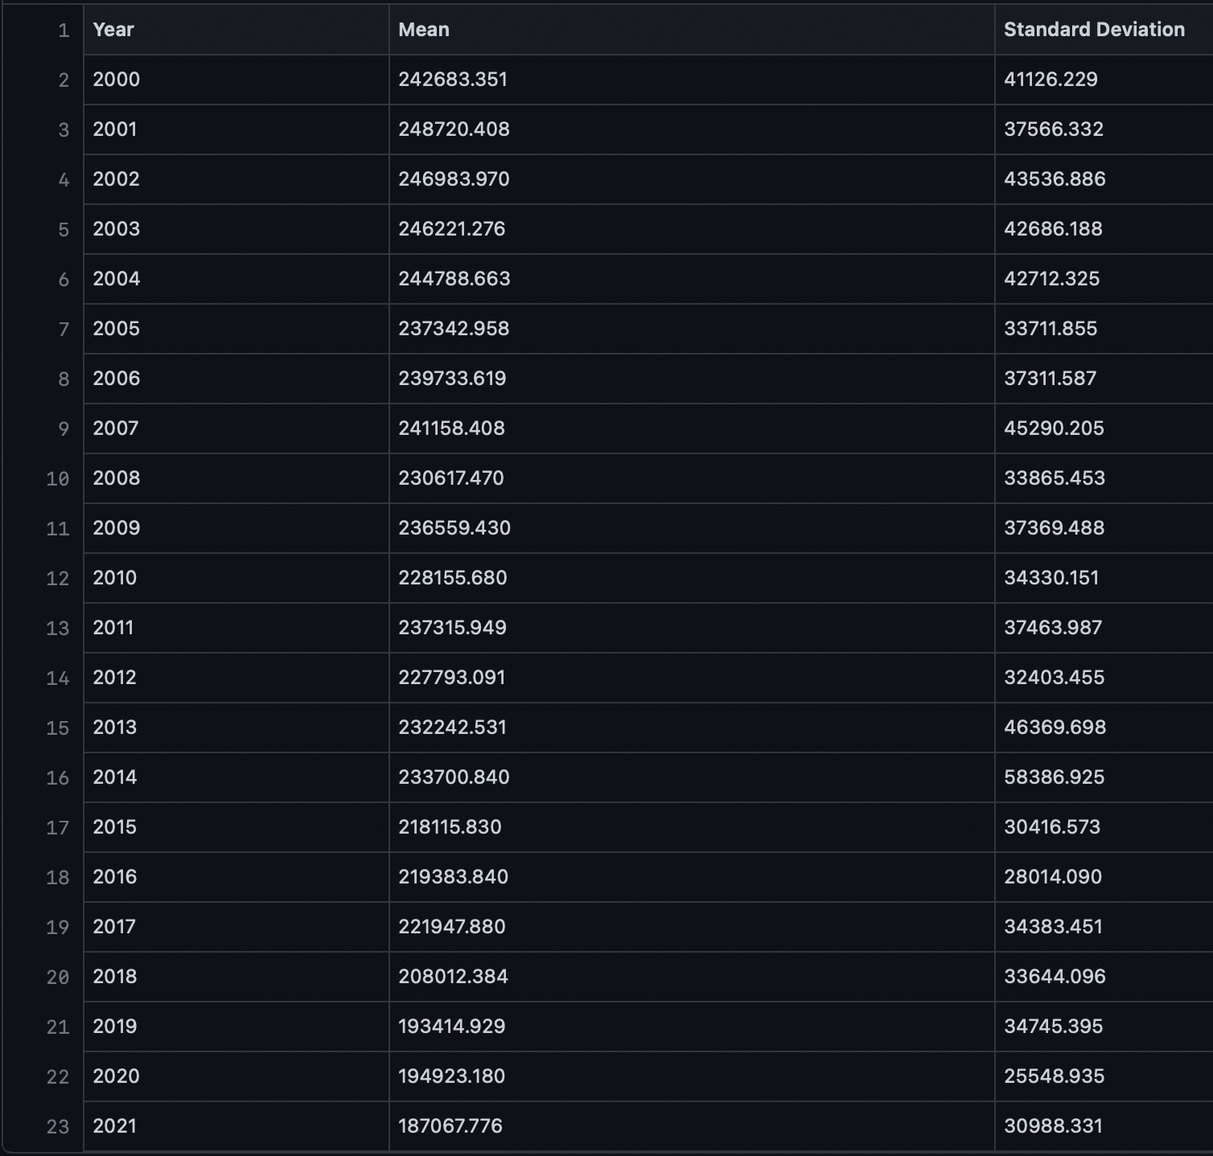
Large decline in both mean and standard deviation
Average starts at a steady 240,000 but then declines ending at 200,000
Music has a certain duration to be successful for the highest chance to succeed..
Notes:
The duration average from 2000 has been on the decline, with there being a steeper decline from 2014 onwards. Also the standard deviation has fluctuation but as a whole has decreased.
From 2000 to 2013 the average was about 230,000 ms but on average falls about 1,000ms every 2 years.
The spread also falls but to a smaller amount in comparison to the mean, the std stays at 40,000 up until 2014 then falls to low 30,000s.
Showing that to increase possibility of succeeding the length should between 160,000 and 200,000 ms.

Slide 25
Over the 22 years, it is clear the biggest changes that are to stay for the near future are Energy and Duration. Energy has increased and Duration has decreased, which follows with the introduction of social media. Social Media and the ease of sharing means short content with high energy to keep engagement up is the way to succeed with sales.
Liveness and Instrumentalness have remained a constant throughout with values of 0.25 and 0.025 respectively.
The fluctuations of tempo and speechiness show there is no consistency and may possibly result in have little impact in sales.
Danceability has only changed in the past couple of years, with it having a spike then falling again. Loudness started off getting quieter but is not on the up with it getting louder.
Notes:
Over the 22 years, it is clear the biggest changes that are to stay for the near future are Energy and Duration. Energy has decreased and Duration has decreased, which follows with the introduction of social media. Social Media and the ease of sharing means short content with high energy to keep engagement up is the way to succeed with sales.
Liveness and Instrumentalness have remained a constant throughout with values of 0.25 and 0.025 respectively.
The fluctuations of tempo and speechiness show there is no consistency and may possibly result in have little impact in sales.
Danceability has only changed in the past couple of years, with it having a spike then falling again.
Loudness started off getting quieter but is not on the up with it getting louder.

Slide 26
The Most Streamed Artists

Slide 27
Why are some Artist more popular than others?
CSV file formatted for Python analysis.
CSV uploaded and converted to a Data Frame
Data Frame cleaned for analysis
Started analysis : created Bar Charts to show Artists tracks reaching 10 Million, 100 Million and over 2 Billion streams from the top 1000 Artists (image on next slides)
Created Pie charts to visualise Genre distribution amongst top 100 Artist and top 10 Artists
Using the https://chartmasters.org/most-streamed-artists-ever-on-spotify/ data was obtained for analysis.
Excel used to calculate percentage of Tracks in the streaming values and added extra column of Artist Genre types, using Google to find data.
Looking for Artist consistently popular and not occasional hit songs

Slide 28
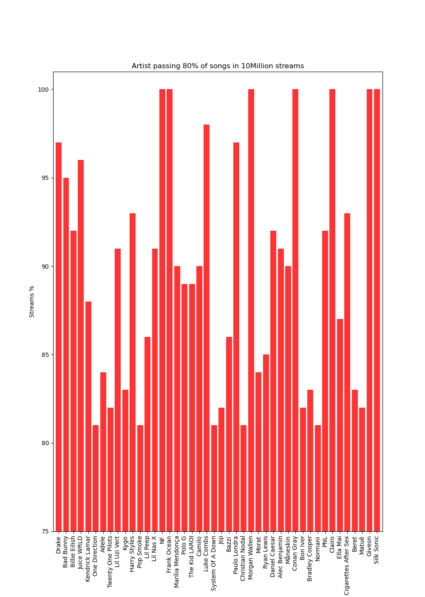
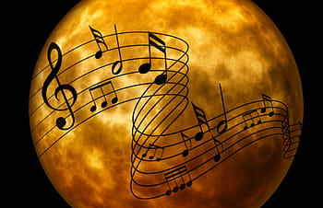

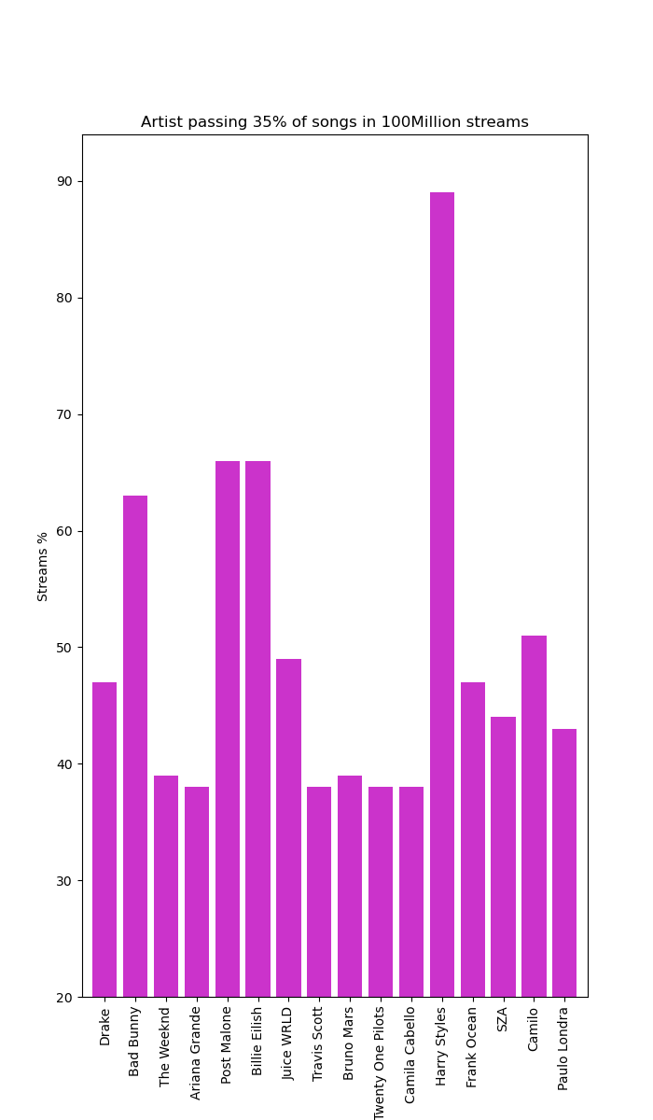
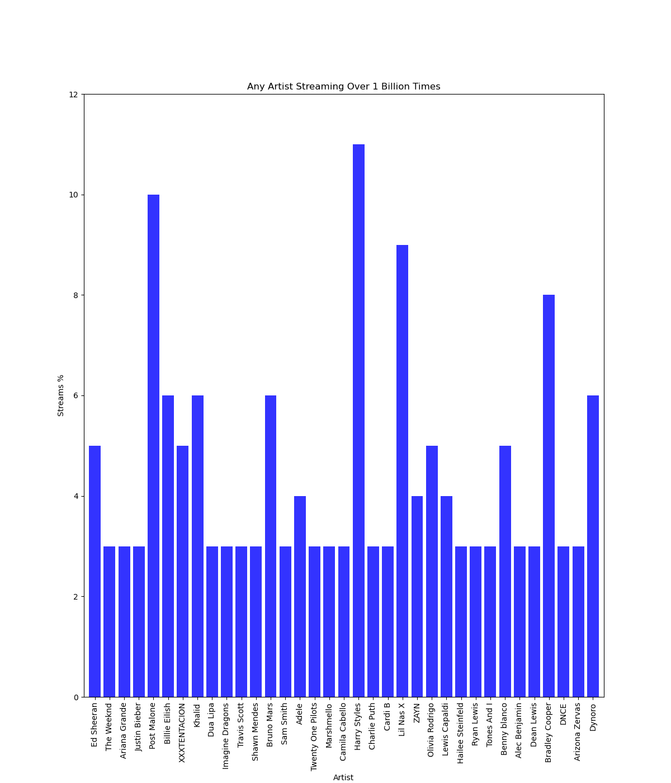
Artists with 35% or more Tracks Streaming 100 Million Times
Artists with 2 or more Tracks Over 1 Billion Times
Artists with 80% or Greater Tracks Streaming 10 Million Times
Notes:
In the top 1000 Artists The Number of Artists with the majority of their Tracks (80%) streaming 10 Million Times is : 44 35% = 16 > 2 Billion= 35
In the top 1000 Artists The Sum of All Artist streams over 10 Million: 2515 35% = 723 > 2 Billion= 119
looking at first bar chart 5 artist around 80% 12 artist reaching 95% and above and remainder 27 artist between 80% - 95%.

Slide 29
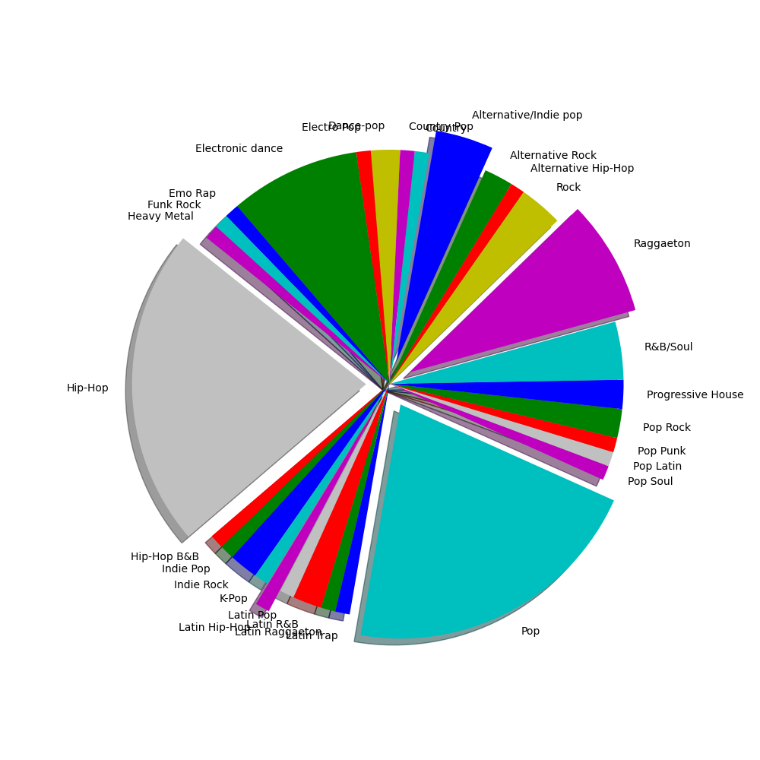
Pie Chart Depicting Top 100 Artists Genre Type
31 Genre Types in Top 100 artists
Clearly can see two main Genre groups
Lots of similar genres
Mixture of genres
Note: Many artists did not solely use one genre but for the benefit of the analysis the main genre was chosen that Google returned.

Slide 30
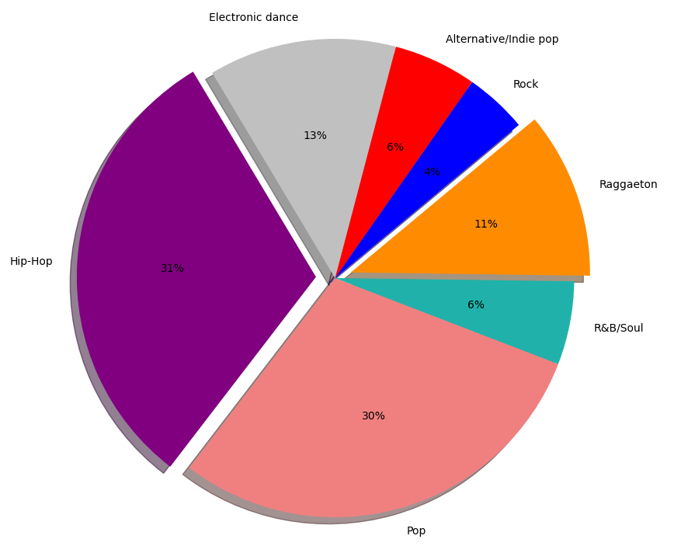
Pie Chart Depicting Top 10 Artists genres
 | Max Tracks | Min Track | Total No. Tracks
10 Million | Taylor Swift (246) | Post Malone (65) | 1712
100 Million | Drake (117) | Post Malone (54) | 736
1 Billion | Ed Sheeran (10) | Taylor Swift & BTS(1) | 49
The Artist with most released tracks was Taylor Swift with (319)
The Artist with the least released tracks was Post Malone (82)
Notes:
looking at Post Malone who had the least number of tracks reaching 10M and 100M but was second highest reaching 1 Billion and had the fewest tracks released

Slide 31
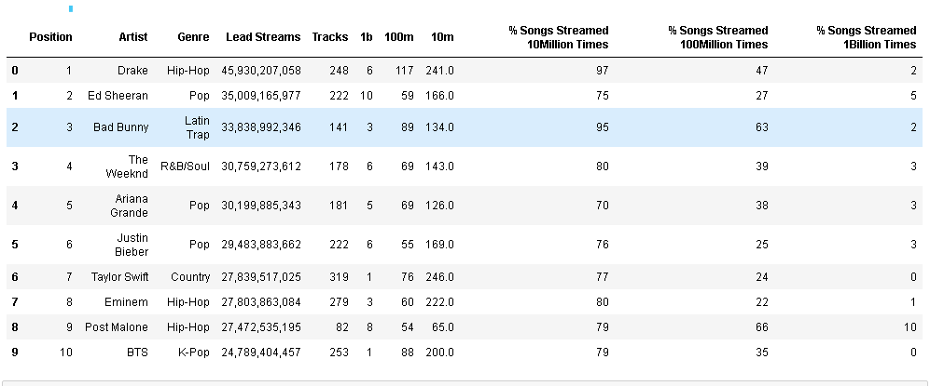
Artists Analysis:
Why are some Artist more popular than others? :
Genre types seems to have some effect on the popularity of the most streamed tracks
Limitations
Dataset used could have been more comprehensive including track length, gender, sales revenues, group/single artist, artist location, artist career span, release dates, and online presence/popularity.
Notes:
The most popular Artist is : Drake with 97% of his tracks streaming 10 Million times and almost half of his tracks streaming 100 Millions and 2% of tracks streaming 1 Billion times. Most popular Genre is: Hip-Hop (31%) and Pop (30%)

Slide 32
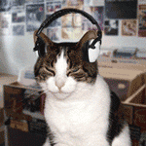
Thank you!

